Slide 1
AWS Global Accelerator

Slide 2
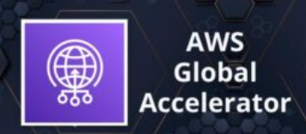
AWS Global Accelerator
AWS Global Accelerator is a service that improves the availability and performance of applications with local or global users.
It provides static IP addresses that act as a fixed entry point to application endpoints in a single or multiple AWS Regions, such as Application Load Balancers, Network Load Balancers or EC2 instances.
Uses the AWS global network to optimize the path from users to applications, improving the performance of TCP and UDP traffic.
AWS Global Accelerator continually monitors the health of application endpoints and will detect an unhealthy endpoint and redirect traffic to healthy endpoints in less than 1 minute.

Slide 3
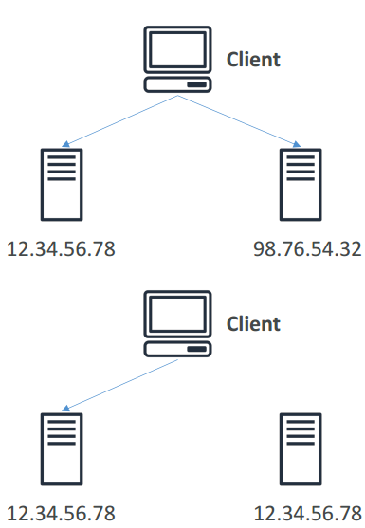
Unicast IP vs Anycast IP
Unicast IP: one server holds one IP address.
Anycast IP: all servers hold the same IP address and the client is routed to the nearest one.

Slide 4
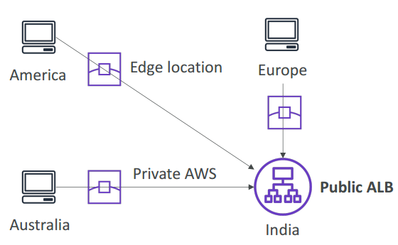
AWS Global Accelerator
Leverage the AWS internal network to route to your application
2 Anycast IP are created for your application
The Anycast IP send traffic directly to Edge Locations
The Edge locations send the traffic to your application

Slide 5
AWS Global Accelerator
Works with Elastic IP, EC2 instances, ALB, NLB, public or private
Consistent Performance
Intelligent routing to lowest latency and fast regional failover
No issue with client cache (because the IP doesn’t change)
Internal AWS network
Health Checks
Global Accelerator performs a health check of your applications
Helps make your application global (failover less than 1 minute for unhealthy)
Great for disaster recovery (thanks to the health checks)
Security
only 2 external IP need to be whitelisted
DDoS protection thanks to AWS Shield

Slide 6
AWS Global Accelerator vs CloudFront
They both use the AWS global network and its edge locations around the world
Both services integrate with AWS Shield for DDoS protection.
CloudFront
Improves performance for both cacheable content (such as images and videos)
Dynamic content (such as API acceleration and dynamic site delivery)
Content is served at the edge
Global Accelerator
Improves performance for a wide range of applications over TCP or UDP
Proxying packets at the edge to applications running in one or more AWS Regions.
Good fit for non-HTTP use cases, such as gaming (UDP), IoT (MQTT), or Voice over IP
Good for HTTP use cases that require static IP addresses
Good for HTTP use cases that required deterministic, fast regional failover

Slide 7
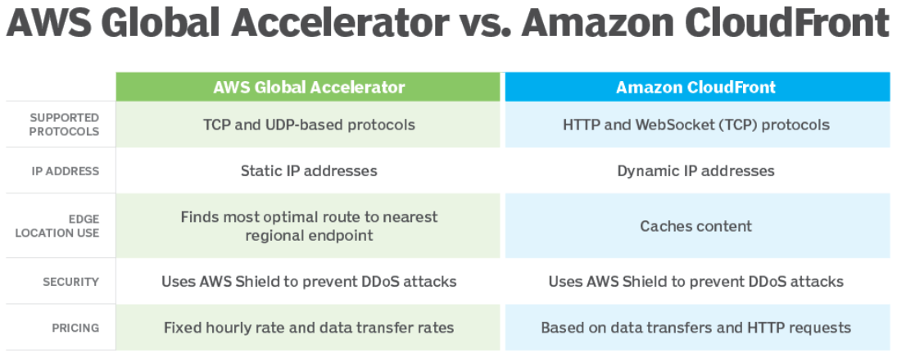
AWS Global Accelerator vs CloudFront

Slide 8
AWS Global Accelerator use cases
Scale for increased application utilization
Acceleration for latency-sensitive applications
Disaster recovery and multi-Region resiliency
Protect your applications
Improve performance for VoIP or online gaming applications

Slide 9
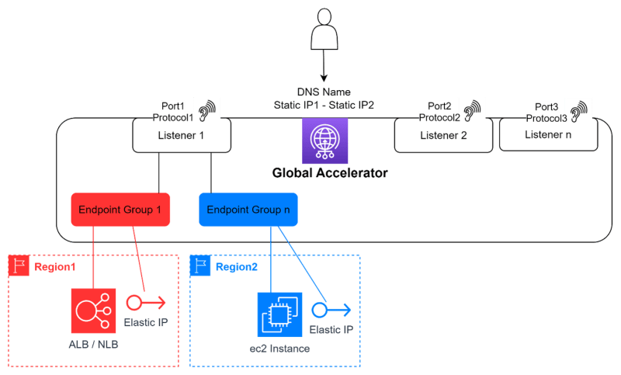
Global Accelerator

Slide 10
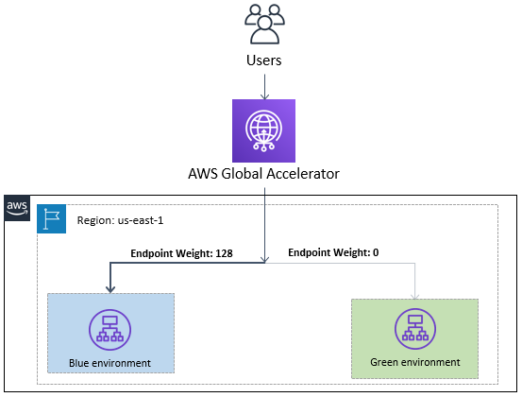
AWS Global Accelerator Blue/Green Deployment

